Slide 1
안내사항
스폰서 슬라이드는 발표자료 맨 앞과 맨 뒤에 한 장씩 넣어주세요
Please retain the sponsor slides at the beginning and end
스폰서 슬라이드는 발표하실 때 언급을 하셔도 되고 안하셔도 되지만, 꼭 보여주셔야 합니다
It’s up to you to mention those sponsor slide during your talk, but please retain both

Slide 2


Slide 4
<Session Title>
<Speakers>

Slide 5
Agenda
Subject A
Subject B
Subject C

Slide 6
Subject A

Slide 7
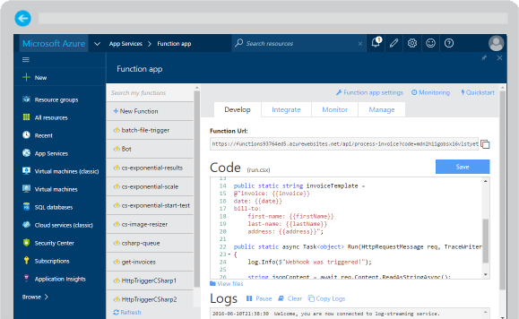
Azure Functions
Reusable nanoservices
Serverless
Event based
…

Slide 8
Subject B

Slide 9
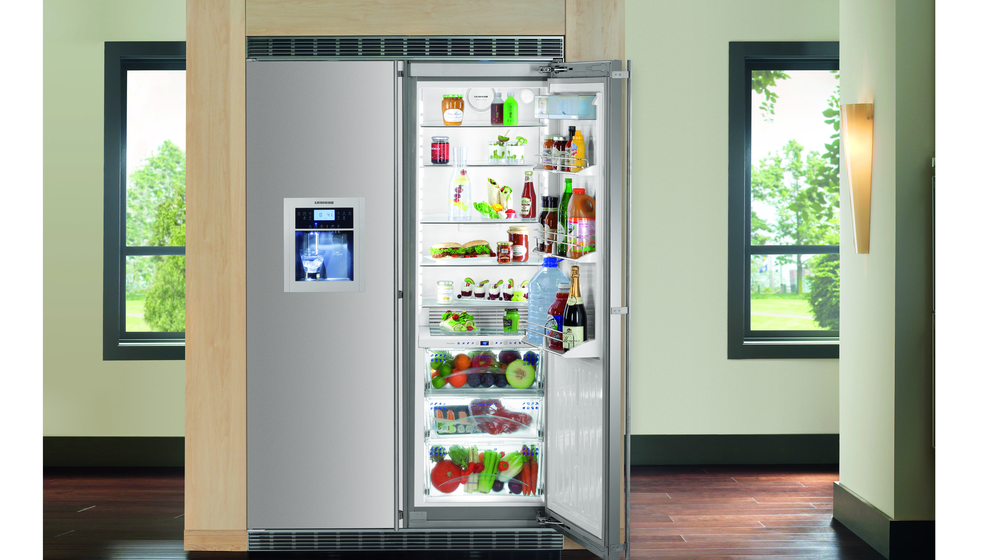
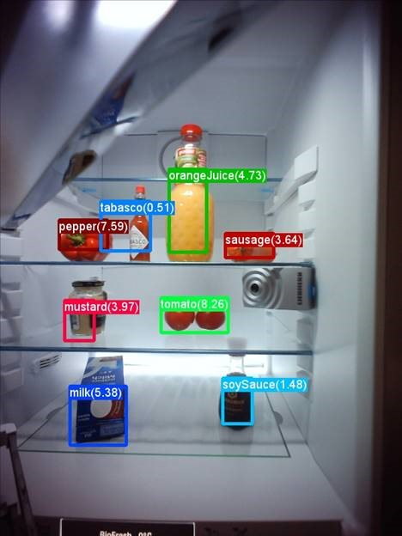

Smart Refrigerator

Slide 10
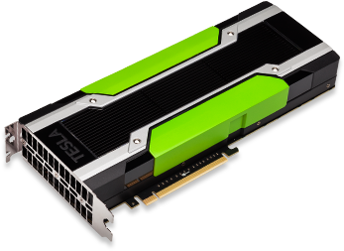
Azure NC-Instances
 | NC6 | NC12 | NC24 | NC24r
Cores | 6 | 12 | 24 | 24
GPU | 1 K80 GPU (1/2 Physical Card) | 2 K80 GPUs (1 Physical Card) | 4 K80 GPUs (2 Physical Cards) | 4 K80 GPUs (2 Physical Cards)
Memory | 56 GB | 112 GB | 224 GB | 224 GB
Disk | ~380 GB SSD | ~680 GB SSD | ~1.5 TB SSD | ~1.5 TB SSD
Network | Azure Network | Azure Network | Azure Network | InfiniBand

Slide 11
Call to Action
Azure Batch Shipyard @ https://github.com/Azure/batch-shipyard
Cognitive toolkit @ https://cntk.ai
Learn more about Azure N-Series on Channel 9
Re-visit Connect on Channel 9.

